Slide 1
MASPOE’s
MVP Poll application
3th BSc Business Engineering
Database systems & Data Structures

Slide 2

OVERVIEW
01
About MASPOE
02
Our Team
03
Beginning
04
Strategy
05
Result
06
Future plans

Slide 3

ABOUT MASPOE
Belgian event-organizing organization
Focused on sports, culture and entertainment
Managing Sports & Events
Bring people together through movement and shared experiences
Vicaris Village, a 3-day festival they organize in Dendermonde

Slide 4
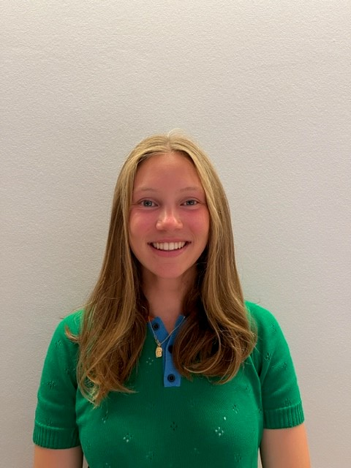




Our Team
Judith Ceuppens
General Manager
Louis Van Linden
Backend Engineer
Arjen
Sap
Database Architect
Korneel
Pennewaert
Frontend Developer
Kasper
De Vos
Database Architect

Slide 5
Beginning
Had to find own business
Maspoe wanted site
Settled on poll system ➔ didn’t know which artists to book
Notes:
Which artists should they book?

Slide 6




Strategy
1
2
3
4
5
ERD &DDL
Flask app
Complex algorithm
Presentation and finishing touch
User Stories

Slide 7
User stories
As a user, I want to view available polls and submit a vote or suggestion, so that I can actively participate in the Vicaris Village selection process.
Users can submit a vote via the polling interface
Users can suggest an artist using a form
As a user, I want to view clear and structured poll results and submitted suggestions, so that I can understand the collective preferences of the community.
As an admin, I want to manage artists, editions and polls, so that the Vicaris Village application remains accurate, up to date and scalable for future events.
Notes:
First j

Slide 8
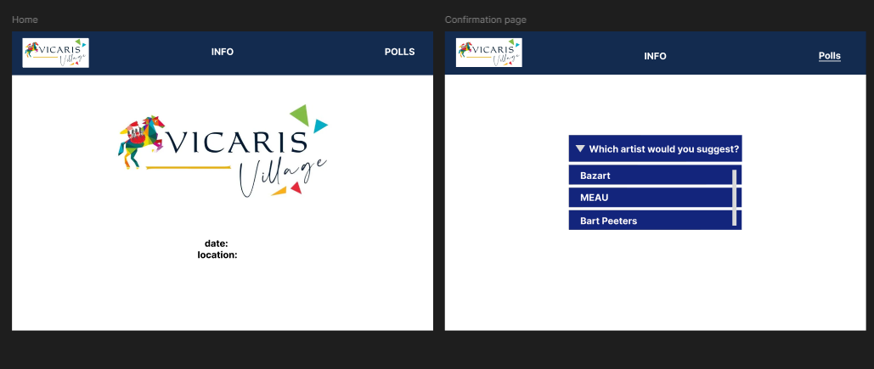
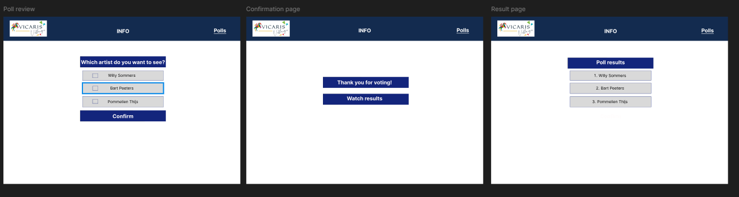
User Interface with Figma (initial)

Slide 9
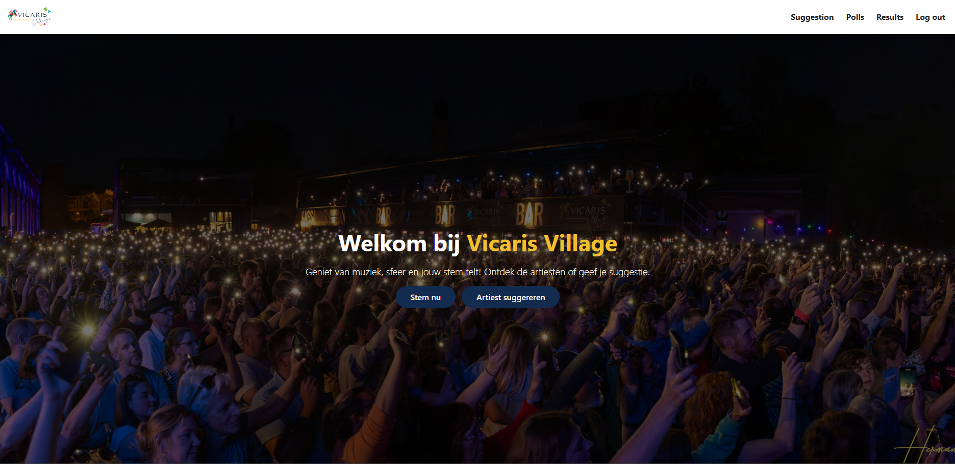
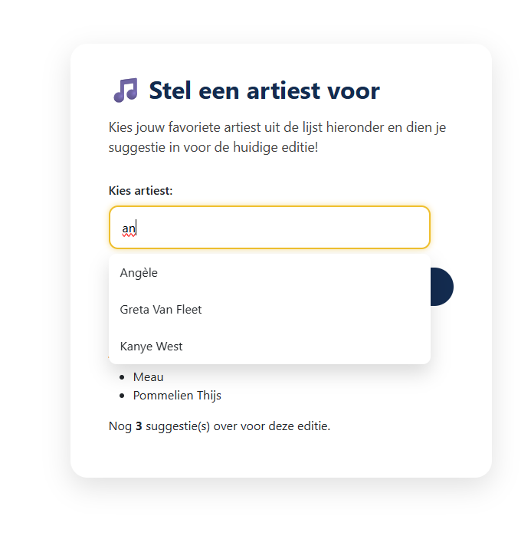
User Interface (now)

Slide 10
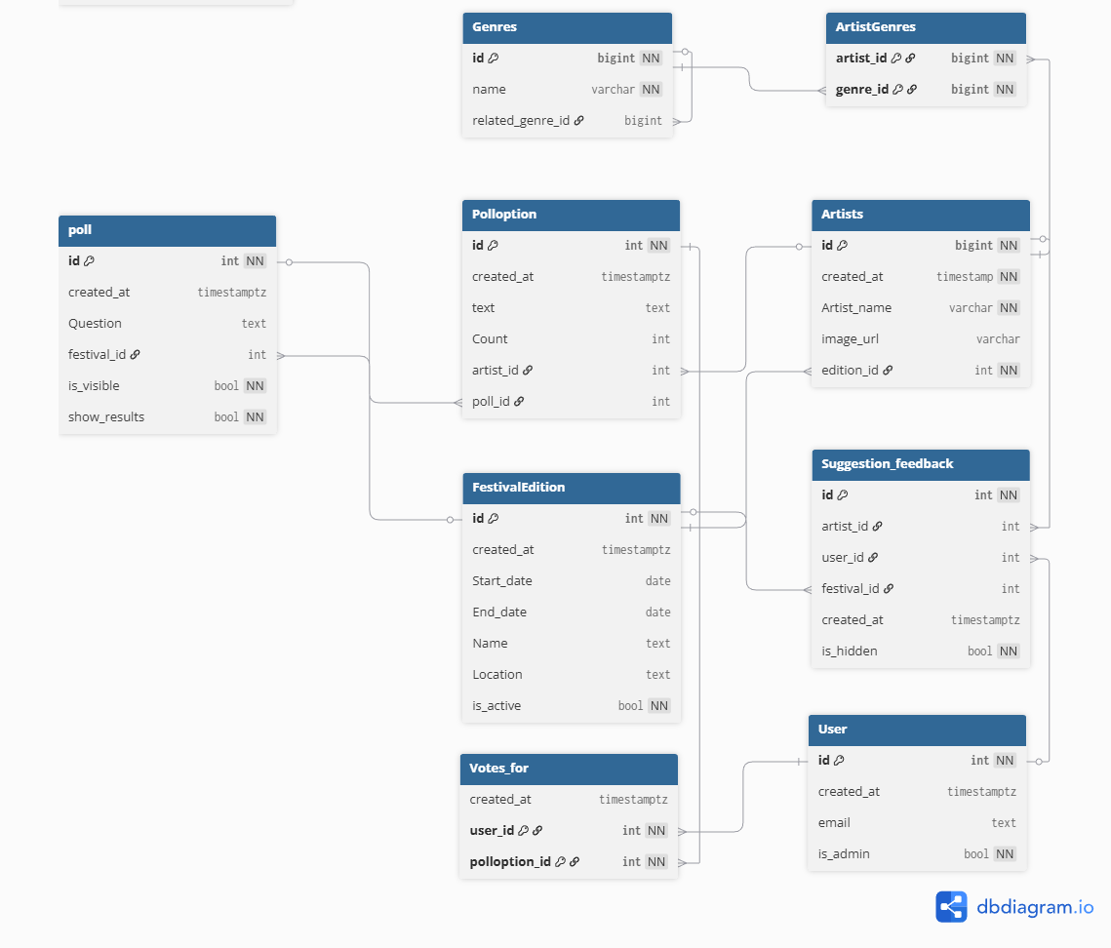
ERD
9 entities
42 attributes
Each entity has 1 or more primary keys
Relationships implemented using foreign keys
N:M relationships resolved using junction tables

Slide 11
Festival Edition
Our poll application works for multiple festivals
Possible to adapt the edition

Slide 12
Overall architecture
Flask application factory (create_app())
Central models.py using SQLAlchemy
Blueprints in app/routes/
HTML templates in app/templates/
Static assets in app/static/
Business logic in app/services/
Helper utilities in app/utils/
Notes:
Our project follows a standard Flask architecture based on an application factory called create_app(). All database models are centralised in models.py and handled using SQLAlchemy. We divide the application logic into several blueprints inside app/routes such as core, auth, suggestions, poll, and admin. The templates folder contains all Jinja2 HTML files, and static files like CSS and images are stored under static. More complex logic is placed inside the services folder, while reusable helper functions go into utils. This keeps the project clean, modular, and easy to extend.

Slide 13
Flask app
create_app() loads configuration (Config)
Initializes database (db.init_app)
Enables Flask-Migrate
Registers all blueprints
Context processors:
current_user
poll_visibility
suggestions_visibility
results_visibility
@app.before_request-hook: always an active poll
Notes:
Inside create_app() we load our configuration settings, such as the database URL and the secret key. We initialize SQLAlchemy and Flask-Migrate so we can manage database updates easily. All blueprints are registered here so the app knows which route files to use. We also define context processors, which inject variables like current_user or visibility flags for polls, suggestions, and results into every template. This allows us to control what appears in the navigation bar depending on the user and the active edition.

Slide 14
Routes
core.py --> homepage
auth.py --> register / login / logout
suggestions.py -->artist suggestions (max. 5 per edition)
poll.py --> poll loading, voting, and results
admin.py --> admin dashboard
admin_editions.py --> edition management
Notes:
We organise our routes into blueprints based on functionality. core.py contains the homepage and basic routes. auth.py handles user registration, login, and logout. In suggestions.py, users can submit artists for a specific edition. poll.py contains everything related to viewing polls, voting, and showing poll results. For administrators, we have admin.py and admin_editions.py, which allow managing users, artists, and festival editions. This separation makes the project much easier to maintain.

Slide 15
Database models
User --> authentication + is_admin
FestivalEdition --> edition details + active flag
Artists — artists linked to an edition
Genres + ArtistGenres --> many-to-many relationship
SuggestionFeedback --> user suggestions per edition
Poll, Polloption, VotesFor --> complete poll system
Notes:
All database models are defined using SQLAlchemy. User stores authentication details and whether a user is an admin. FestivalEdition represents a festival edition and includes start and end dates as well as an active flag. Each artist belongs to an edition, and we link artists to genres via the many-to-many table ArtistGenres. SuggestionFeedback tracks which user suggested which artist. For the poll system, we use three models: Poll for the poll itself, Polloption for the artists included, and VotesFor to store the user’s vote.

Slide 16
Services and business logic
poll.py service:
get_active_festival()
get_or_create_poll_for_edition()
get_or_create_active_poll()
genre_profile.py service:
Builds user music profile from suggestions
Generates personalized poll options
session.py utility:
get_session_user()
Notes:
We moved more complex logic out of the routes and into services. The poll service decides which festival edition is active and ensures that a poll exists for that edition. The genre profile service analyzes a user’s suggestions, determines their preferred genres, and generates personalized poll options. In the utilities folder we handle session logic, such as retrieving the logged-in user from the session cookie. This separation keeps the routes clean and ensures that our logic can be reused across the app

Slide 17
Algorithmic support
Builds a user genre profile based on suggestions
Scores artists using genre similarity
Selects top-ranked artists for personalised polls
Notes:
Our application uses algorithmic support to personalise polls for users. Based on the genres of artists a user has suggested, we build a genre profile that reflects their musical preferences. We then score all available artists by comparing their genres with the user’s profile, taking genre similarity into account. The highest-scoring artists are selected as personalised poll options.

Slide 18
Strenghts
Useful for festivals
Easy to use for customers
Easy to filter artists for admin
Upscaleable
Everyone can vote
Sorted into genres

Slide 19
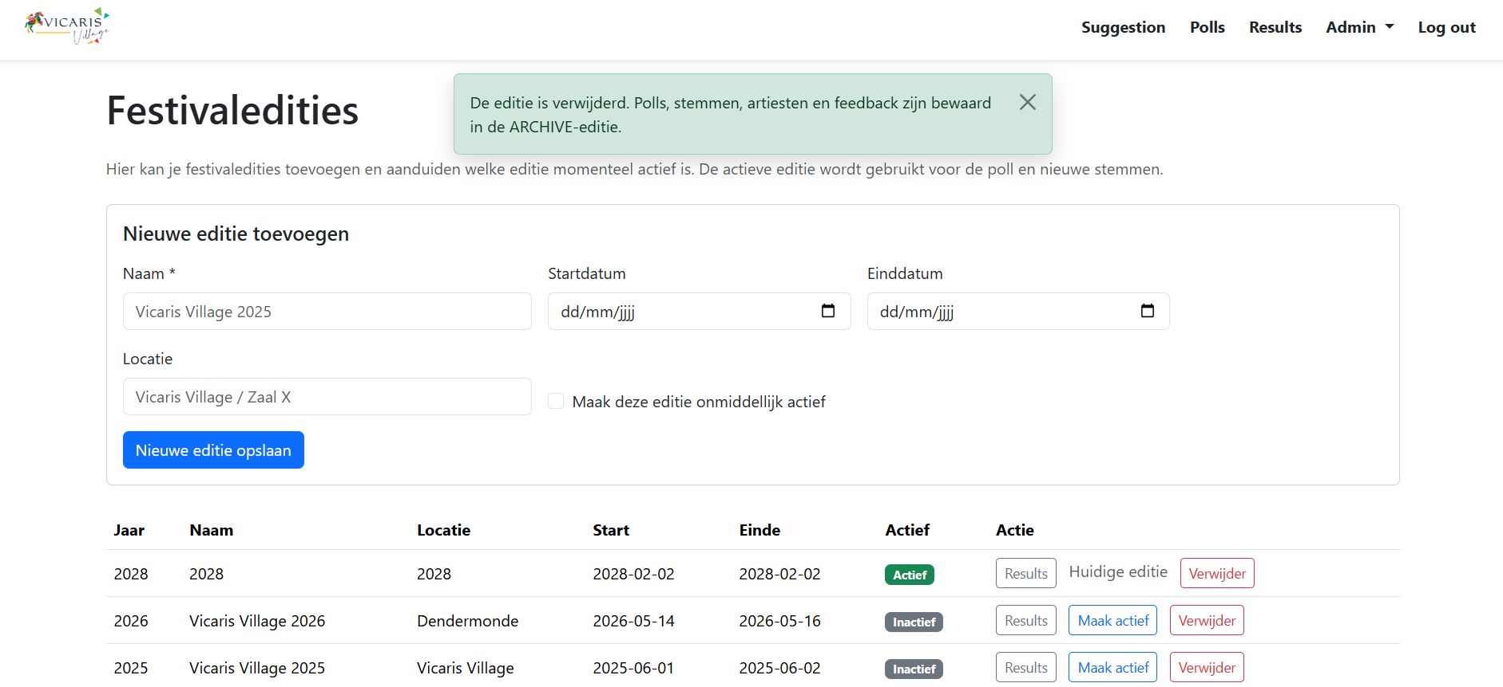
Upscalability

Slide 20
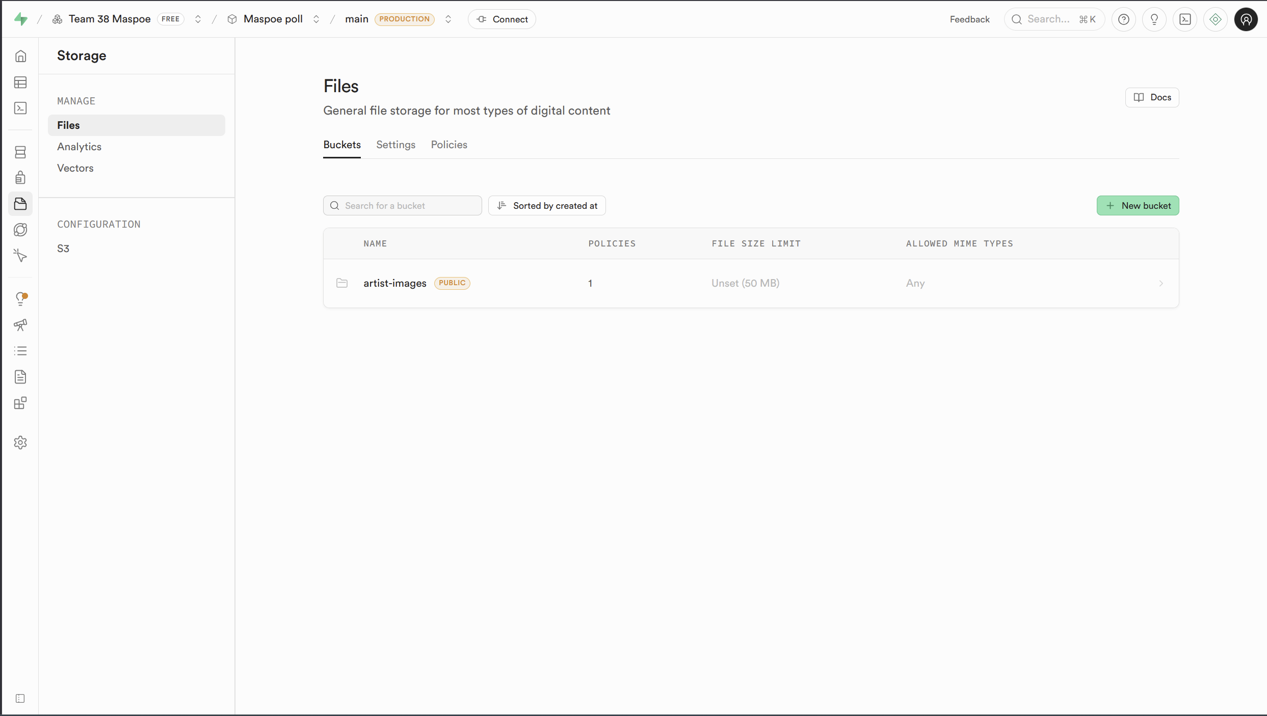
Image storage as an upscaling strategy
Current approach
Images stored on the filesystem
Database only stores the relative image path
Flask serves images via dynamic static routing
Upscaling option
Move images to a Supabase Storage Bucket
Keep only the image URL/path in the database
Improved scalability, performance and deployment flexibility
Notes:
“At MVP level, images are stored locally and the database only keeps the relative path. For future scalability, this setup can easily be migrated to Supabase Storage without changing the database structure.”

Slide 21
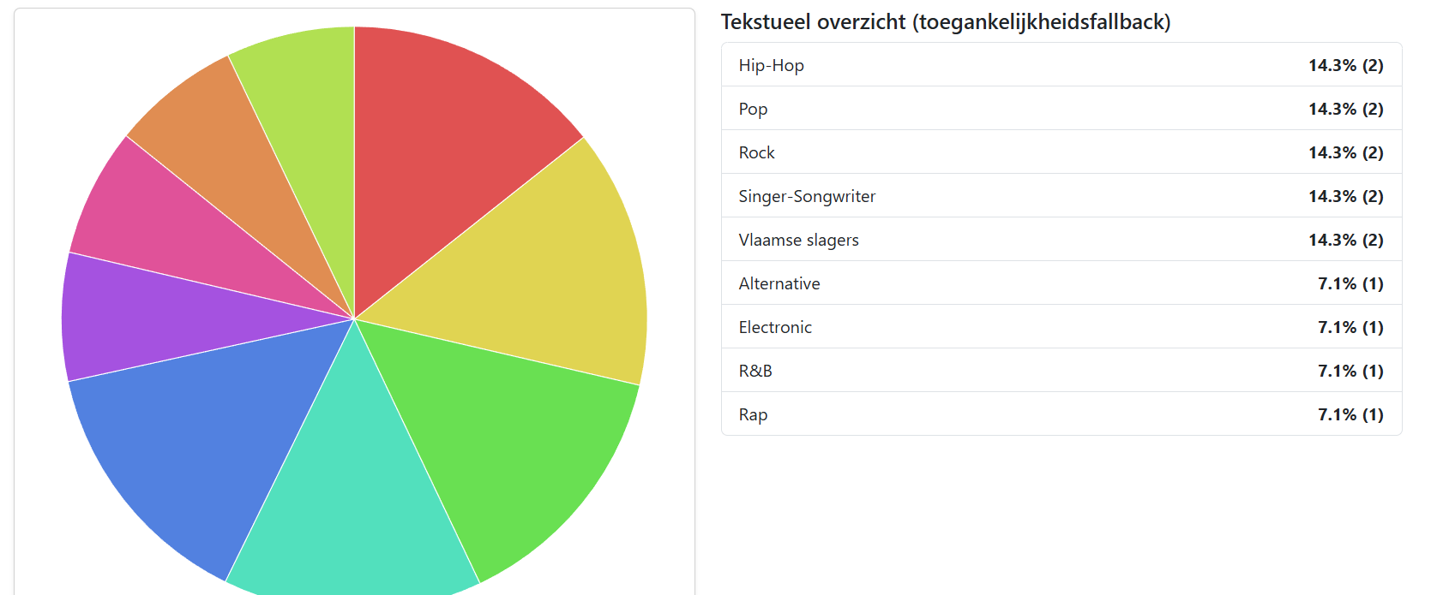
Result

Slide 22
The future
Making it more accessible for more festivals
Making it easier for the organisers to edit
Upscaling

Slide 23
Kanban
Team 38 Maspoe - Miro
Not possible anymore to edit

Slide 24

Thank you for listening
Group 38

Slide 25
Appendix
Site Maspoe
MVP render – polls
Team 38 kanban - Miro

Slide 26
Q&A

Slide 27
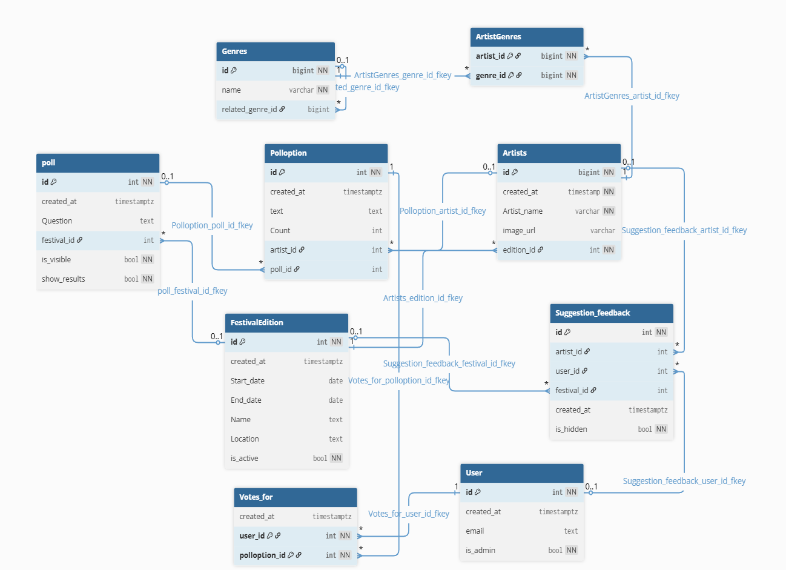
Notes:
CardinaliteitArtist – GenreN : M
FestivalEdition – Artist1 : N
FestivalEdition – Poll1 : N
Poll – Polloption1 : N
Artist – Polloption1 : N
User – Polloption (via Votes_for)N : M
User – Suggestion_feedback1 : N
Artist – Suggestion_feedback1 : N
Genre – Genre0..1 : N
We introduced the ArtistGenres table to correctly model the many-to-many relationship between artists and genres. This avoids redundancy, supports normalization and is essential for our genre-based recommendation algorithm
Votes_for resolves the many-to-many relationship between users and poll options, while also allowing us to store metadata such as the vote timestamp

Slide 28
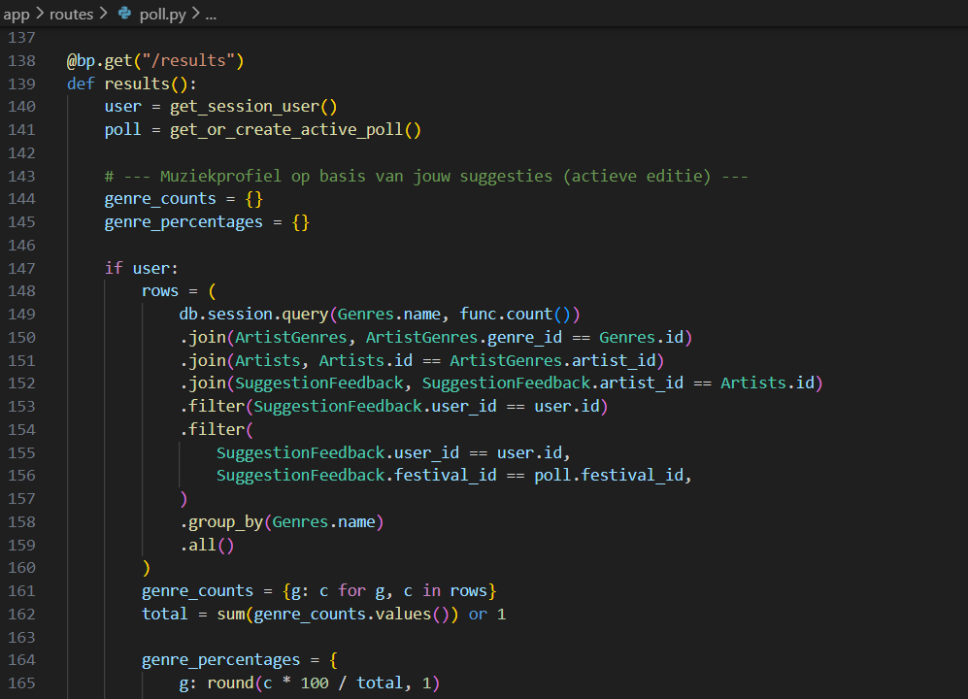
Algorithmic Support
Notes:
The function begins by retrieving the logged-in user and determining the active poll. Next, it analyses all the artists that the user has suggested and counts how often each music genre appears. A database query links genres to artists and filters them by the user’s suggestions. The results are converted into percentages to create a clear overview of the user’s musical preferences. This genre profile later helps to personalise the poll for the user.

Slide 29
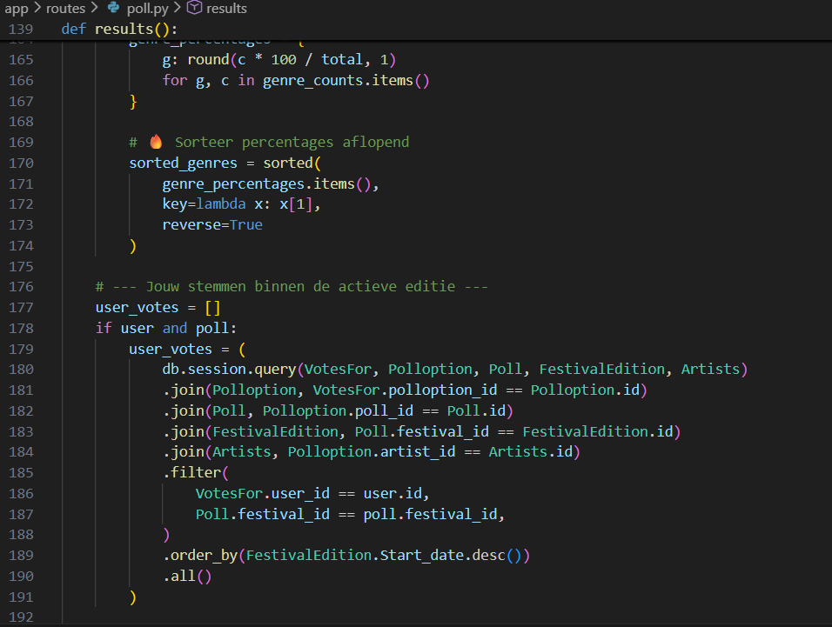
Algorithmic Support
Notes:
After calculating the genre percentages, they are sorted from highest to lowest, showing the user’s favourite genres first. The function then checks which votes the user has already cast in the current festival edition. A multi-table join retrieves detailed information about the selected artists and the poll options. This gives a complete record of the user’s voting history for that edition. The data is later shown on the results page to provide context for the personalised output.

Slide 30
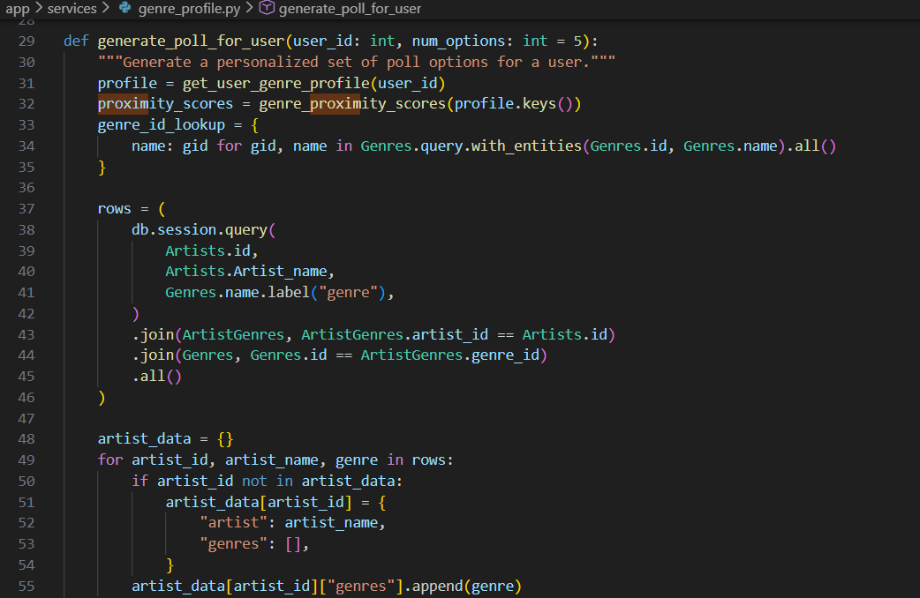
Algorithmic Support
Notes:
The personalised poll generation starts by loading the user’s genre profile and comparing genres to see how closely they relate. A lookup table is created so genres can be matched efficiently by name. All artists are then fetched from the database together with their associated genres. The data is reorganised so that each artist has a list of genres attached to them. This structured dataset is necessary for calculating how well each artist fits the user’s preferences.

Slide 31
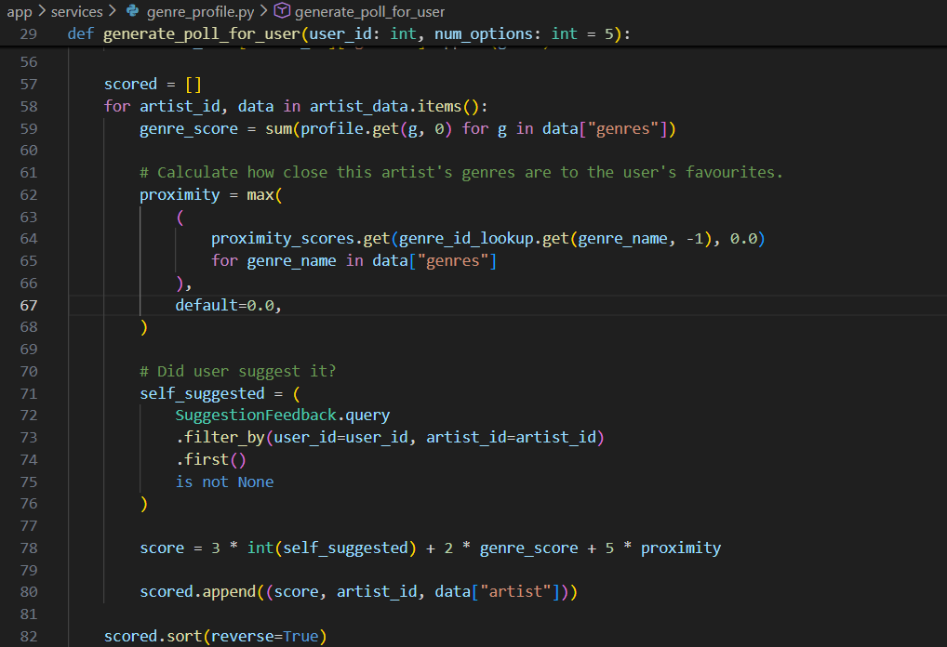
Algorithmic Support
Notes:
Each artist is given a score based on how well they align with the user’s music tastes. The scoring takes into account the user’s favourite genres, the similarity between genres, and whether the user previously suggested the artist. A stronger match results in a higher overall score. Once all artists have been evaluated, the list is sorted from best to worst. The top-scoring artists are then selected as the user’s personalised poll options.

